Slide 1
WEB WORKERS
JAVASCRIPT MULTITHREADING

Slide 2
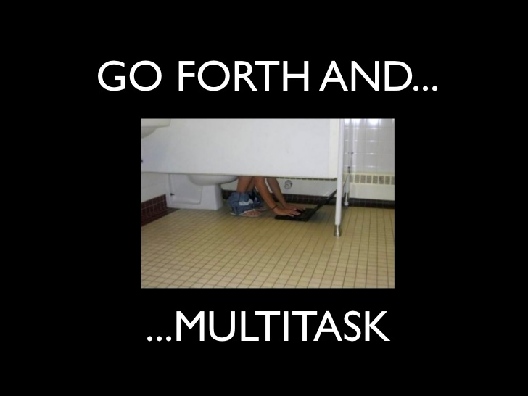

Slide 3
Current scenario
JavaScript code runs in the same thread as the UI.
JavaScript is a single-threaded technology. Only one thing can be done at a time.
This is fine at first, but when JavaScript is doing any heavy-lifting, it can lock up the browser. Locking up the browser is bad, very bad.

Slide 4
What are Web Workers
API for running scripts in the background
Independently of any user interface scripts
Workers are separate JavaScript processes running in separate threads
Workers execute concurrently
Workers don’t block the UI
Workers allow you to extract up to the last drop of juice from a multicore CPU
Workers can be dedicated (single tab) or shared among tabs/windows

Slide 5
…
Might be partially replaced by Window.setTimeout() function
If we call function by setTimeout, the execution of script and UI are suspended
When we call function in worker, it doesn’t affect UI and execution flow in any way.
To create Worker, we put JavaScript in separate file and create new Worker instance:
var worker = new Worker(‘extra_work.js’);
We can communicate with worker using postMessage function and onmessage listener.

Slide 6
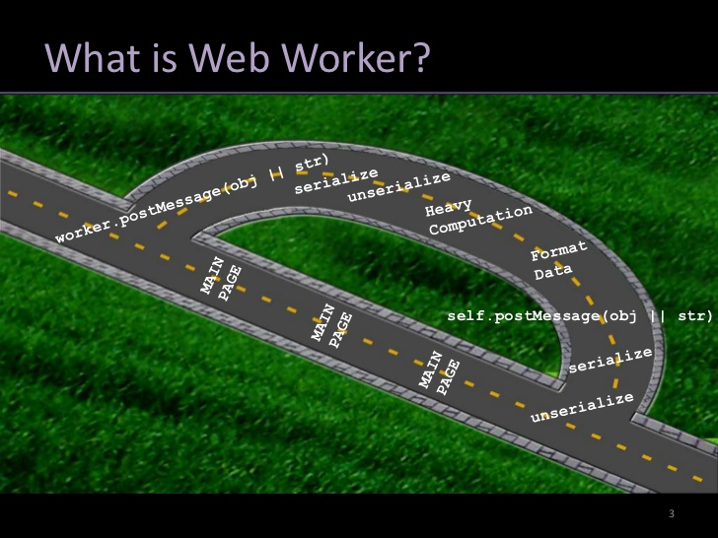

Slide 7
Messages are send to all threads in our application:
MAIN.JS:
var worker = new Worker(‘extra_work.js');
worker.onmessage = function (event) { alert(event.data); };
extra_work.js:
//do some work; when done post message.
// some_data could be string, array, object etc.
postMessage(some_data);

Slide 8
Limitations:
No Access:
DOM
Window
Document
Parent
Main App Memory/Object
You Do Have Access To
XHR
Navigator , Location
App cache
Import script

Slide 9
Can be used for :-
Background number crunching
Background notification from server to local database
Background updating from server
Search queries
Prefetching data for later use
Process large arrays or JSON responses

Slide 10
Browser Support :-
Chrome 4.0+
Firefox 3.5+
Safari 4.0+
Opera 10.6+
IE 10+

